Slide 1
BINDU (IIT2018105)
AYUSHI GUPTA (IIT2018118)
SANJANA (IIT2018120)
T S CHINMAY (IIT2018138)
NILAANG VASAVA (IIT2018147)
NETWORK SECURITY GROUP ASSIGNMENT-2

Slide 2
TUTORIAL ASSIGNMENT
DIFFERENCE BETWEEN ROUTER AND GATEWAYS

Slide 3
NETWORK EQUIPMENT
ROUTER
GATEWAY
PRIMARY
FUNCTION
1 -It is a hardware device that receives, analyses and transmits the data packets to other networks.
1-Gateway is essentially a device used to communicate between networks which have a different set of protocols and are responsible for converting one protocol to ano

Slide 4
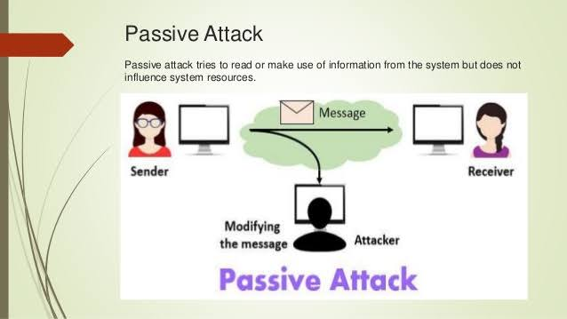
Categories of Network Attacks :
2- Passive Attack - Passive attacks are attacks in which the attacker indulges in an unauthorized eavesdropping and just monitors the transmissions and gathers information.It tries to get system knowledge but does not impact system resources.
Unlike active attacks , they are hard to detect as it does not involves any data manipulation or system resource.

Slide 5
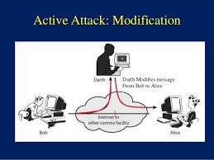
TYPES OF ACTIVE ATTACKS
Modification of Messages - It is an attack in which the attacker alters the packet header addresses so that the message is directed to a different location than the original address that was intended to reach.The information inside the message can also be altered .

Slide 6
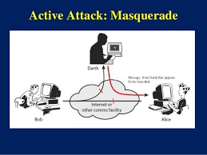
TYPES OF ACTIVE ATTACKS
Masquerade - Masquerade attacks are a form of interruption in which an unauthorized attacker tries to pretend as another entity to gain access or privileges that they are not authorized to.It can be done using stolen login ID and passwords or bypassing the authentication mechanism.

Slide 7
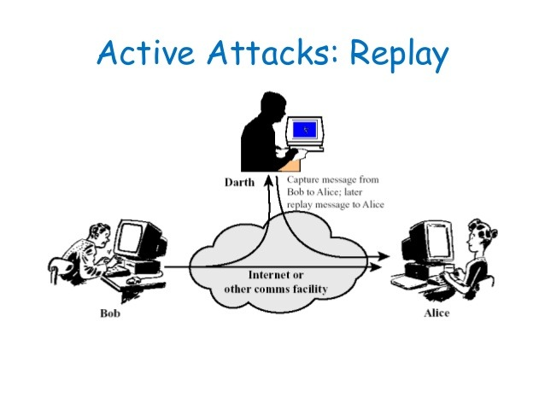
TYPES OF ACTIVE ATTACKS
Replay - In the replay , the hacker passively captures the messages in its way between the sender and receiver and not only he can read the message but also update and modify it and resent them.It can also generate error bit in the messages

Slide 8
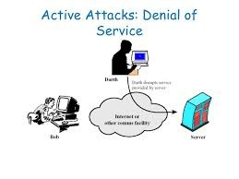
TYPES OF ACTIVE ATTACKS
Denial of Service - It may involve having a specific target.In this the attack the attacker tries to prevent the authorized user to have access to the server.It is done by suppressing the messages that are directed to the particular direction or by disruption of entire network by disabling the networks or overloading it with messages to increase the traffic and so as to degrade the performance.

Slide 9
TYPES OF ACTIVE ATTACKS
Repudiation - A repudiation attack occurs when the user denies the fact that he/she has performed a certain action or has initiated a transaction. The user can simply deny having knowledge of such a transaction or communication and later on claim that such transaction or communication never took place.This attack is either done by sender or receiver.

Slide 10
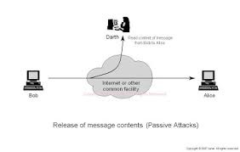
TYPES OF PASSIVE ATTACKS
Release of message content - It includes electronic mails,telephonic conversations and any other transferred file that may contain some sensitive or confidential information that the sender would not want that the contents should be read by any opponent.

Slide 11
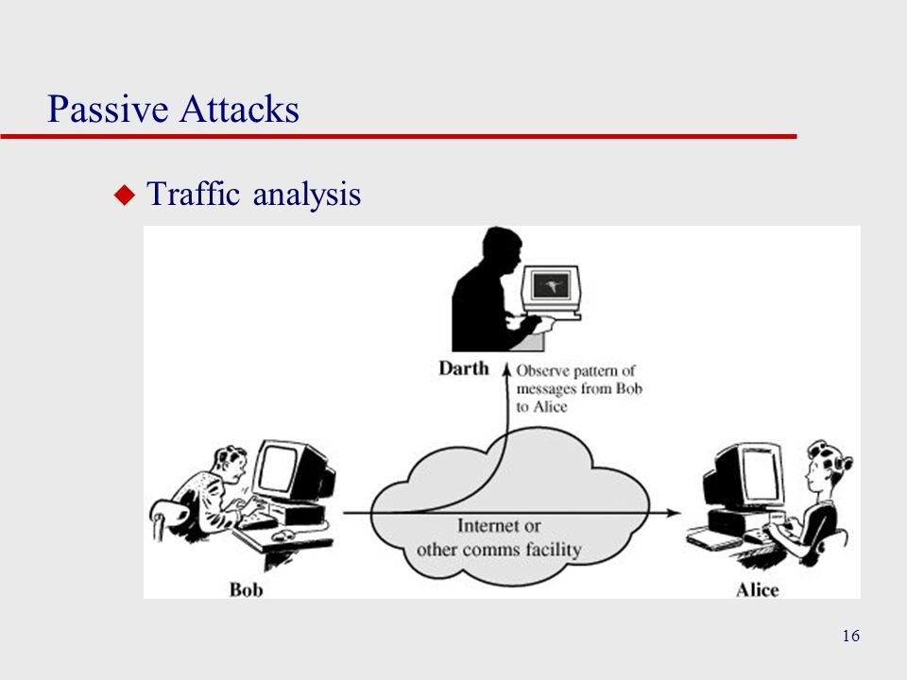
TYPES OF PASSIVE ATTACKS
Traffic Analysis - By using Encryption a message could be masked in order to prevent the extraction of useful information from the message even if it is captured by the attacker. Still the attacker could determine the transmitting host’s identity and location and track the frequency and length of the messages being exchanged.This information can be useful in guessing the nature of the communication taking place.

Slide 12
Brute-Force Attack
Attack Description-
A Brute force attack is a well known breaking technique, by certain records, brute force attacks represented five percent of affirmed security ruptures. A brute force attack includes ‘speculating’ username and passwords to increase unapproved access to a framework. Brute force is a straightforward attack strategy and has a high achievement rate.

Slide 13
Types of Brute Force Attacks:
Dictionary attacks – surmises usernames or passwords utilizing a dictionary of potential strings or phrases.
Rainbow table attacks – a rainbow table is a precomputed table for turning around cryptographic hash capacities. It very well may be utilized to figure a capacity up to a specific length comprising of a constrained arrangement of characters.
Reverse brute force attack – utilizes a typical password or assortment of passwords against numerous conceivable usernames. Focuses on a network of clients for which the attackers have recently acquired information.
Hybrid brute force attacks – begins from outer rationale to figure out which password variety might be destined to succeed, and afterward proceeds with the simple way to deal with attempt numerous potential varieties.
Simple brute force attack – utilizes an efficient way to deal with ‘surmise’ that doesn’t depend on outside rationale.
Credential stuffing – utilizes beforehand known password-username sets, attempting them against numerous sites. Adventures the way that numerous clients have the equivalent username and password across various frameworks.

Slide 14
Rainbow Table versus Dictionary/Brute Force
A rainbow table is generally an offline only attack. In a brute force attack or dictionary attack, you need to spend time either sending your guess to the real system to running through the algorithm offline. Given a slow hashing or encryption algorithm, this wastes time. Also, the work being done cannot be reused.
A rainbow table is precomputed listing. You actually work backwards from the hashed/encrypted text. The attacker will run through the algorithm to get every possible output given every possible input. The list of inputs may be brute force, dictionary, or hybrid. Based on the list of outputs, the attacker now has a reuseable table mapping inputs to known outputs.
With the precomputed table, a simple lookup is now possible given the encrypted/hashed version of the password. If you can find the victim's encrypted/hashed version you can easily return the real plaintext password. Rainbow tables are used to reduce redundant work. There is a trade off with doing the work up front and storing the tables. For example, if you were just doing a brute force or a dictionary attack, you can stop as soon as you find your answer. However, the rainbow table must be fully calculated.
If you were to run a a rainbow table attack and the 5th entry out of 500 million entries was your match, then all of the effort and time used to create the other 499,999,995 passwords may be considered wasted. However, if you are looking to break multiple passwords to reuse the table over multiple attacks, the time savings can add up.

Slide 15

Brute Force Attack
Attack/tools→ Crunch, a password generating tool is used to generate a list of potential passwords. Depending on the parameters passed to the crunch command, (uppercase, lowercase, numbers and symbols) can be arranged in custom ways to accommodate a range of password characters. Using another tool called john the ripper, all of these password values generated from the crunch tool are then hashed and compared to the password file containing the hash that we intend to crack. If there is a match, john the ripper ends and the password is output.
Prevention -
Encrypt your data | Limit logins | Use PBKDF2, BECRYPT, ARGON, Scrypt2 hashing.

Slide 16

Step 1: Run crunch brute force command learn to use crunch for generating word list
Step 2: Check that previous command outputs file on local machine
Step 3: Create a user
Step 4: Combine passwd & shadow files in order to output to text file [ex: chinmay_info.txt]
Step 5: Cat chinmay_info.txt → verify that user and corresponding password hash exists in file
Step 6: Run john the ripper together on both files [crunch password file & user passwd/shadow file]

Slide 17
Step 1:
Crunch brute force command
[ascii-32-95] for more info on rainbow table char-sets
[Crunch Password list generation in Kali Linux] how to generate wordlist
[crunch 6 6 -t @@@123 -f /usr/share/rainbowcrack/charset.txt loweralpha-numeric -o crunch_bruteforce.txt]
Either commands could be if u dont want to use charset file
crunch 4 4 ABCDEFGHIJKLMNOPQRSTUVWXYZ -o /root/Desktop/wordlist.txt
crunch 8 8 ABCDEFGHIJKLMNOPQRSTUVWXYZ -t @@@@1980 -o /root/Desktop/wordlist.txt
crunch 5 5 ABCDEFGHIJKLMNOPQRSTUVWXYZ -o /root/Desktop/wordlist.txt

Slide 18
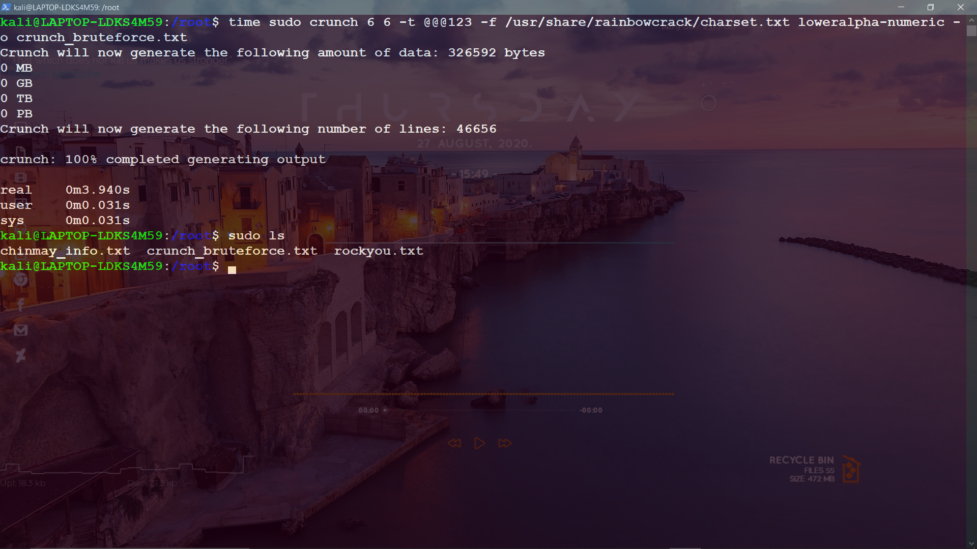

Slide 19
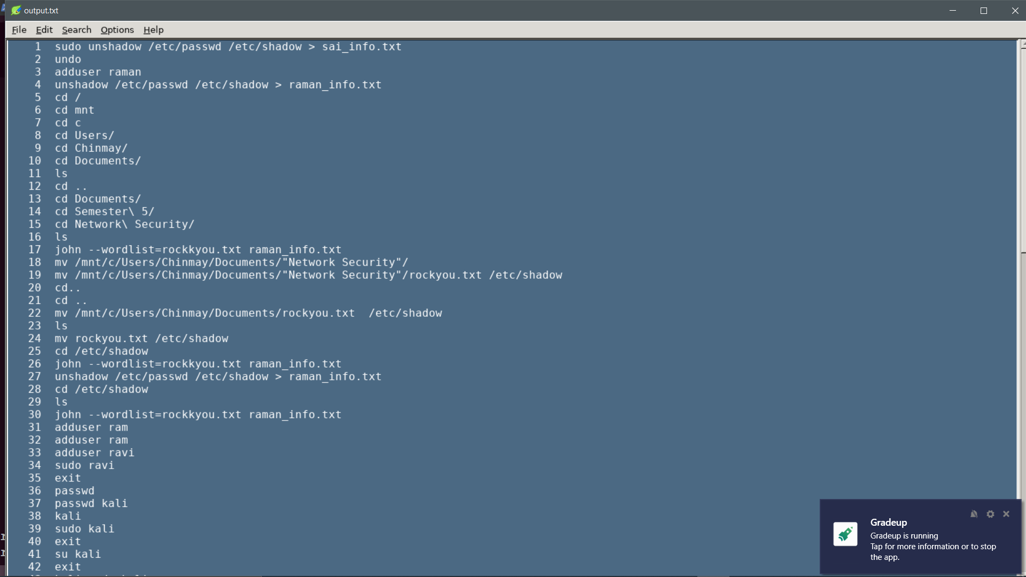
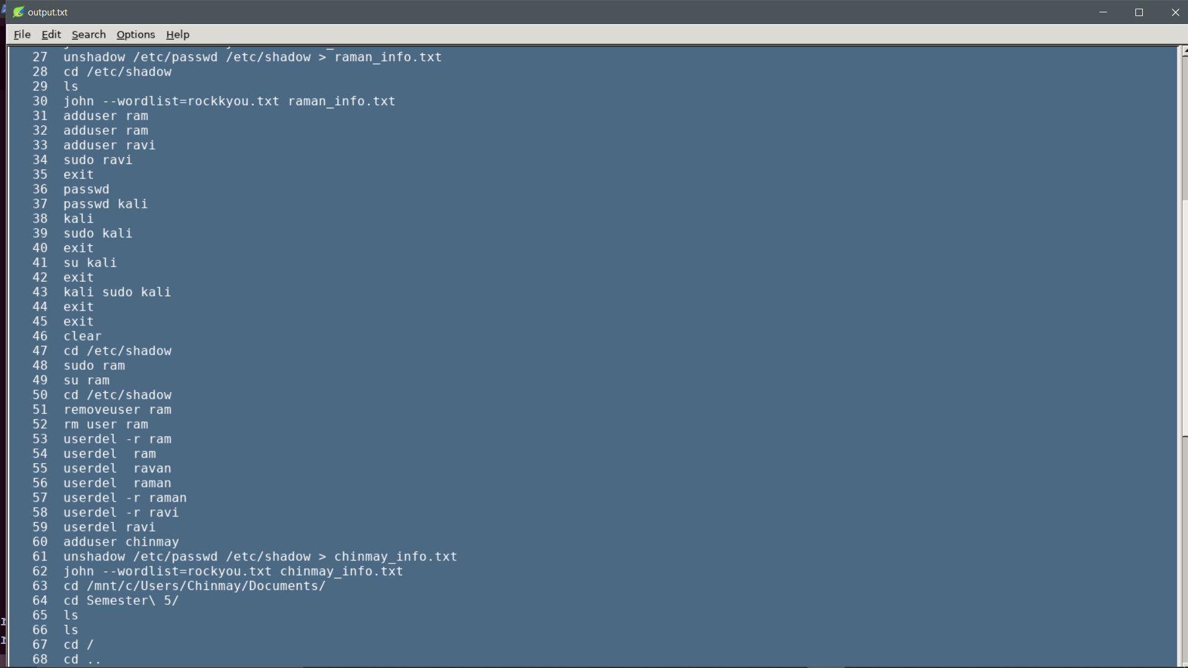
Step 2:
Check that previous command outputs file on local machine

Slide 20
Step 3:
Create a user
Using command : sudo adduser “user_name”
Step 4 :
Combine shadow and password file . eg . chinmay_info.txt
Step 5:
Verify shadow and password file combined file using cat command
Cat chinmay_info.txt
Step 6:
Run john the ripper on crunch_bruteforce.txt over the combined file i.e chinmay_info.txt

Slide 21
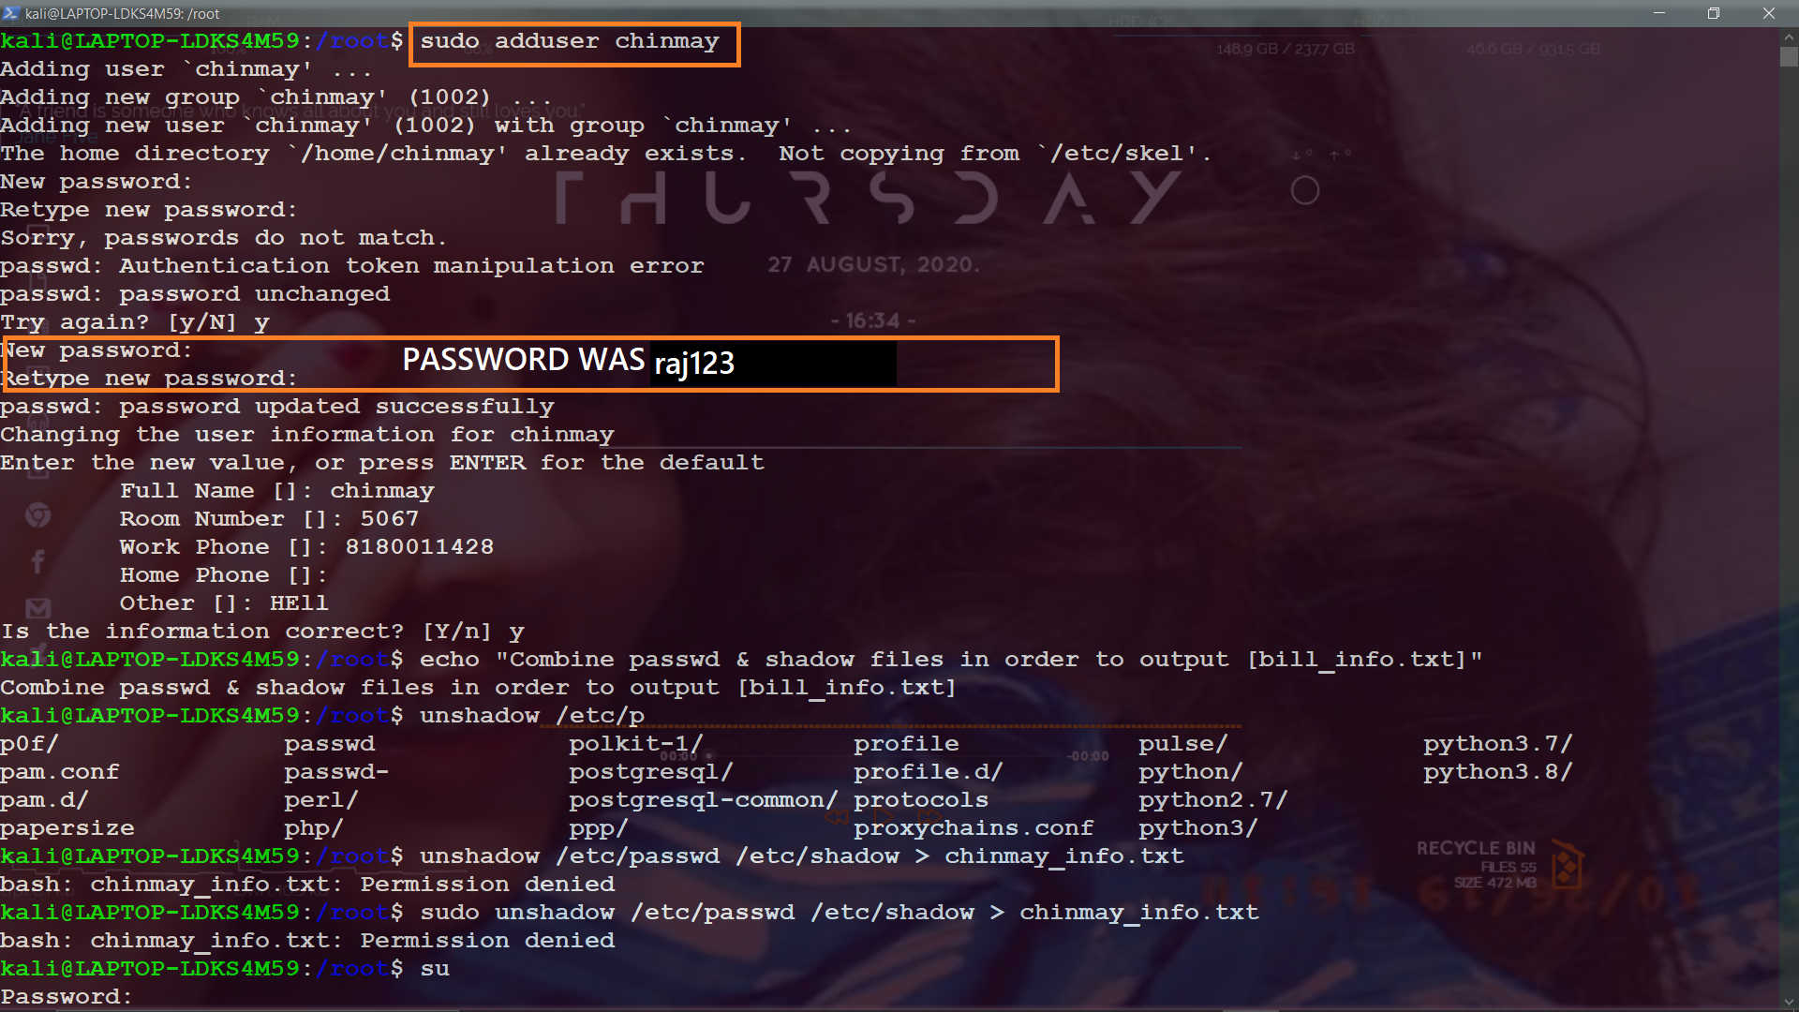

Slide 22
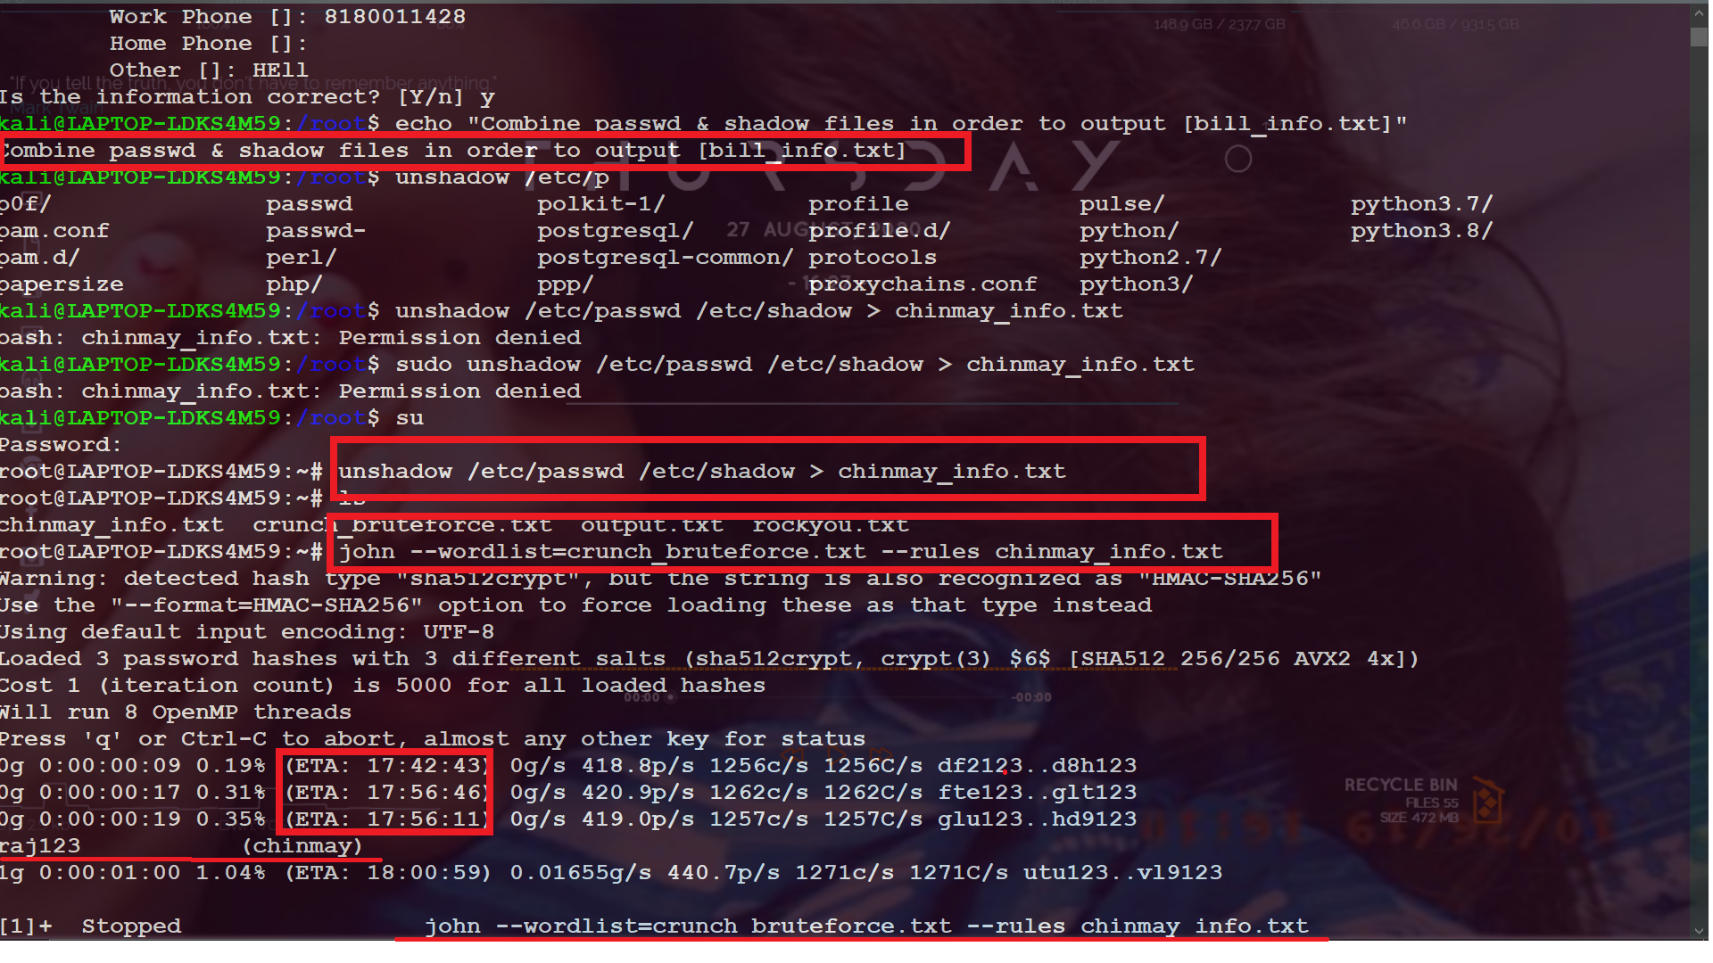

Slide 23
Dictionary Based Attack
Attack/tools→ rockyou.txt, a pre-generated 14 million word list is parsed with john the ripper. The possible password values in the rockyou file are hashed and compared to the password file containing the hash that we intend to crack. If a match exists, the password is cracked and output.
Prevention → Encrypt your data | Limit logins | Use PBKDF2, BECRYPT, ARGON2 hashing
Steps to run dictionary based attack:
Step 1 - Create a user
Step 2 - output passwd and shadow files to new text file
Step 3 - run john the ripper with rock_you dictionary against new text file

Slide 24
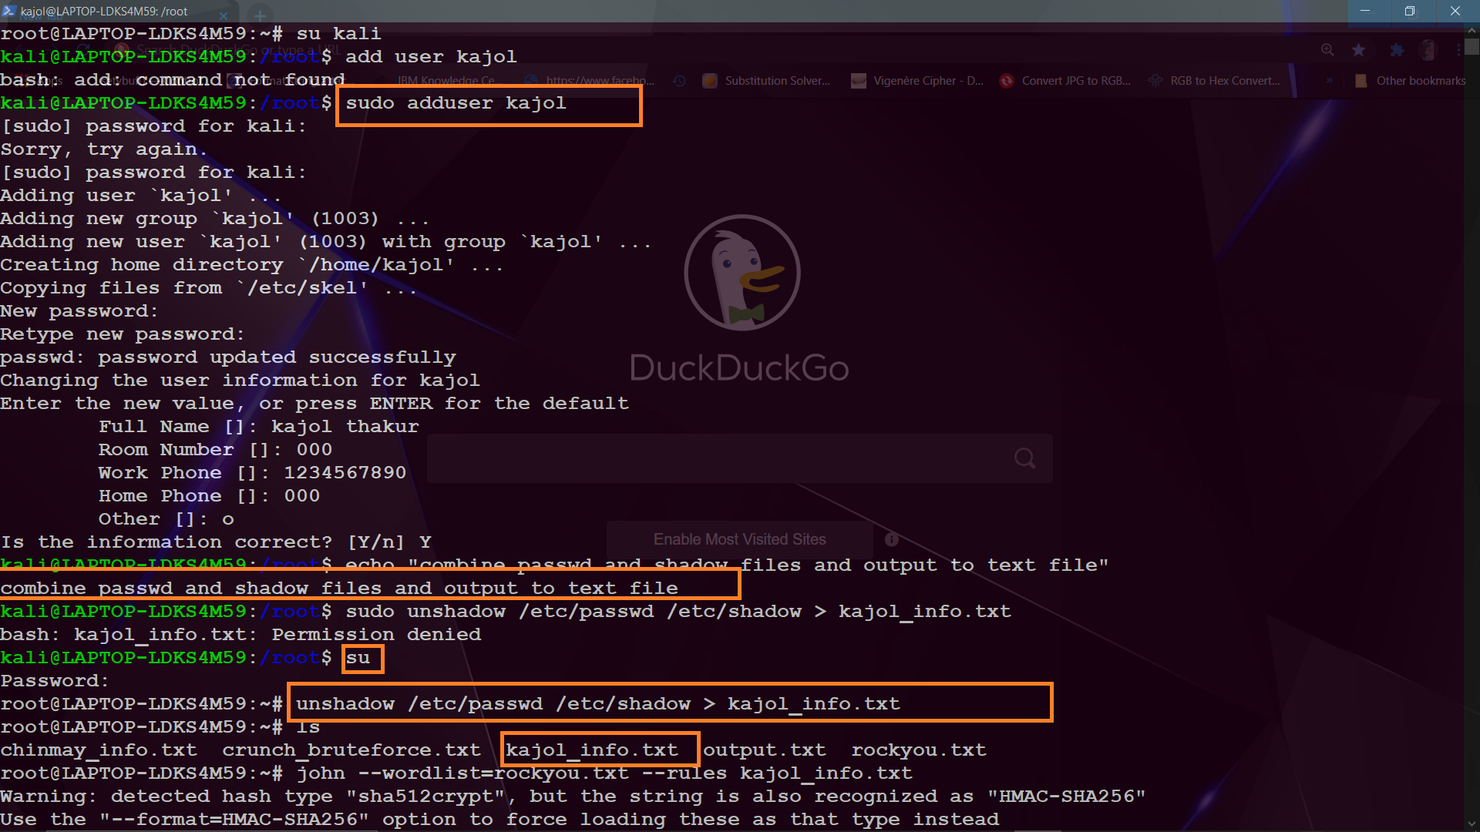

Slide 25
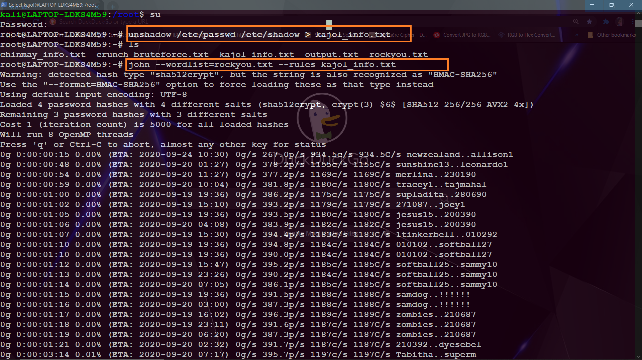

Slide 26
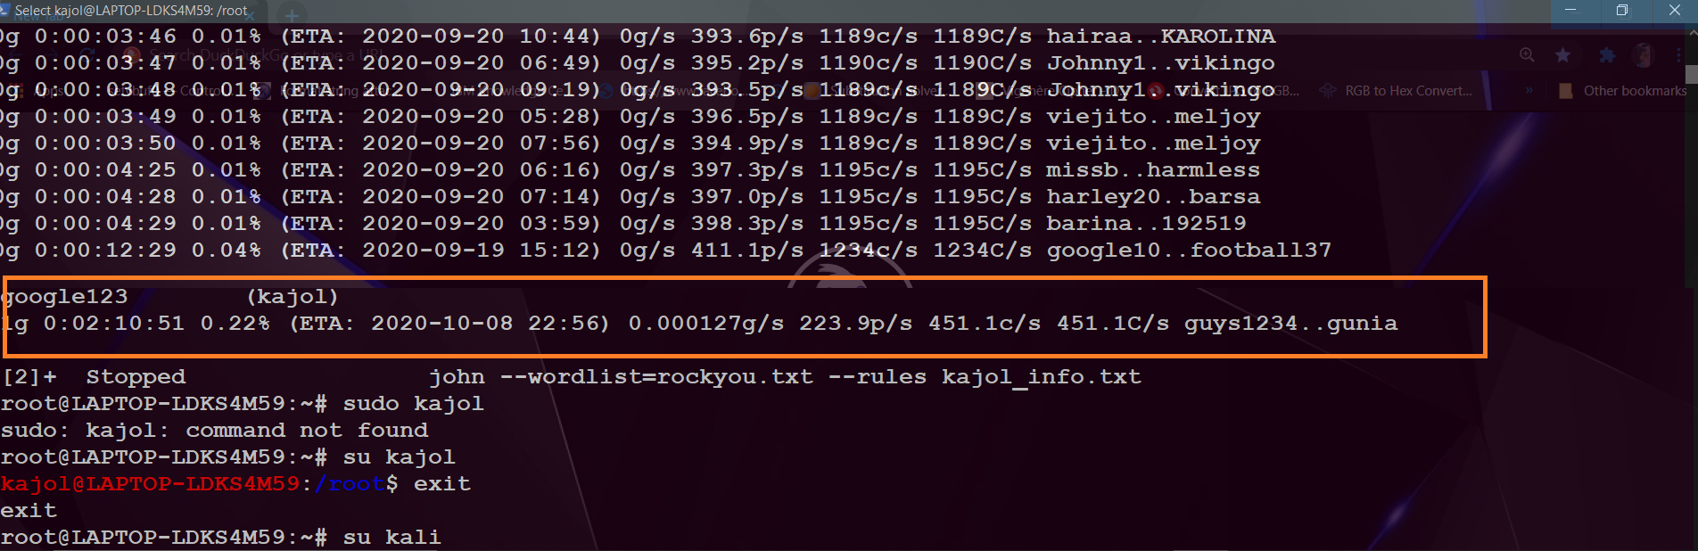
Password found for the user Kajol ie. google123

Slide 27
Rainbow Table Attack
Overview(notes from class): Hash each plaintext one by one, but store each generated hash in a sorted table so that you can easily look the hash up later without generating the hashes again. A hash function maps plaintexts to hashes, the reduction function maps hashes to plaintexts.
Key point: The chains which make up rainbow tables are chains of one way hash and reduction functions starting at a certain plaintext, and ending at a certain hash. A chain in a rainbow table starts with an arbitrary plaintext, hashes it, reduces the hash to another plaintext, hashes the new plaintext, and so on. The table only stores the starting plaintext, and the final hash you choose to end with, and so a chain with millions of hashes can be represented with only a single starting plaintext, and a single finishing hash. [How Rainbow Tables work]
Time memory tradeoff - what you lose in memory, you gain in time.

Slide 28
Steps to run Rainbow table attack:
Step 1 - [download ophcrack & ophcrack tables - vista free and vista proba free]
Step 2 - create password dumpfile from pwdump7 console output
Step 3: Verify that pwdump file includes the usernames and password hashes for the local windows machine
Step 4: open pwdump file in ophcrack
Step 5: crack windowspasswords.txt file in 4 seconds

Slide 29
Step 1:
[http://ophcrack.sourceforge.net/] for Ophcrack download (all platforms)
[http://ophcrack.sourceforge.net/tables.php] for both vista free and vista proba free downloads
[www.tarasco.org/security/pwdump_7/] for downloading pwdump
Extract & upload both tables to Ophcrack.
[tables → install → (navigate to/select table file → open) → repeat for both table files ]

Slide 30
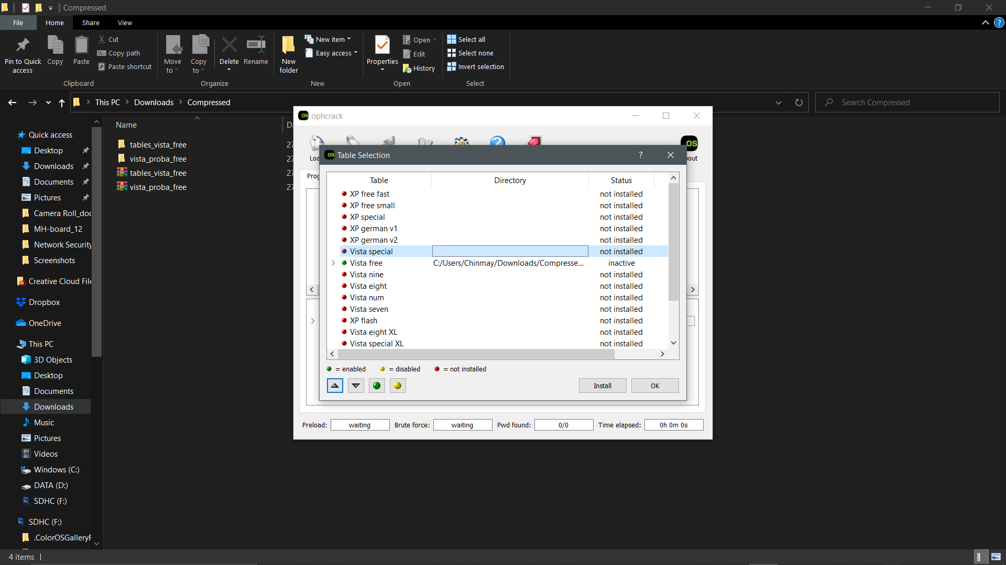

Slide 31
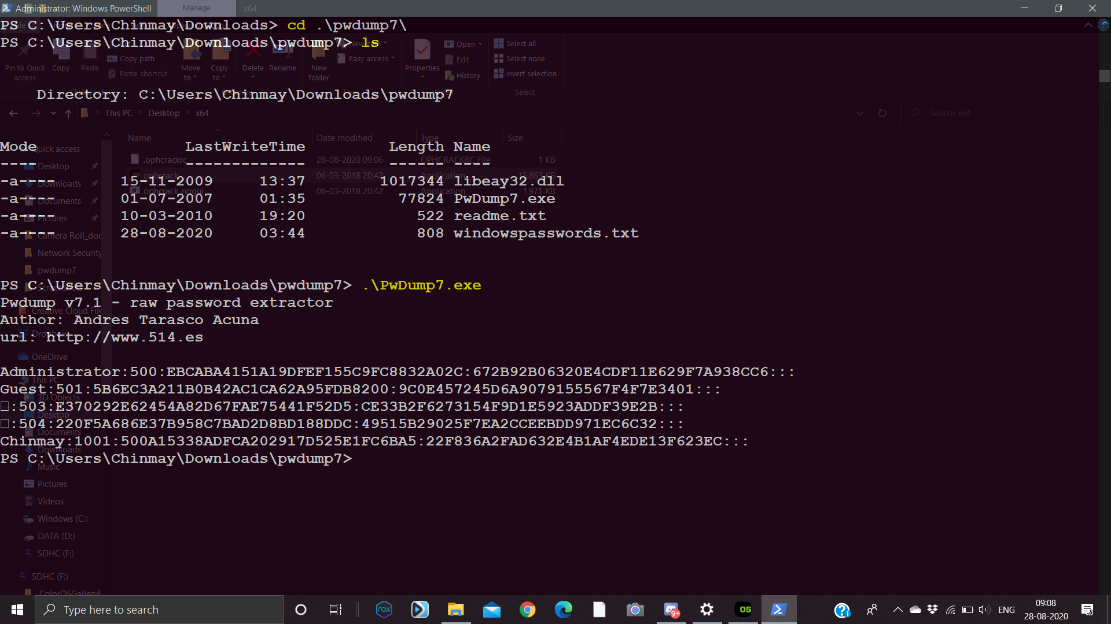
Step 2:
Run as admin to create password dumpfile from pwdump7 console output

Slide 32
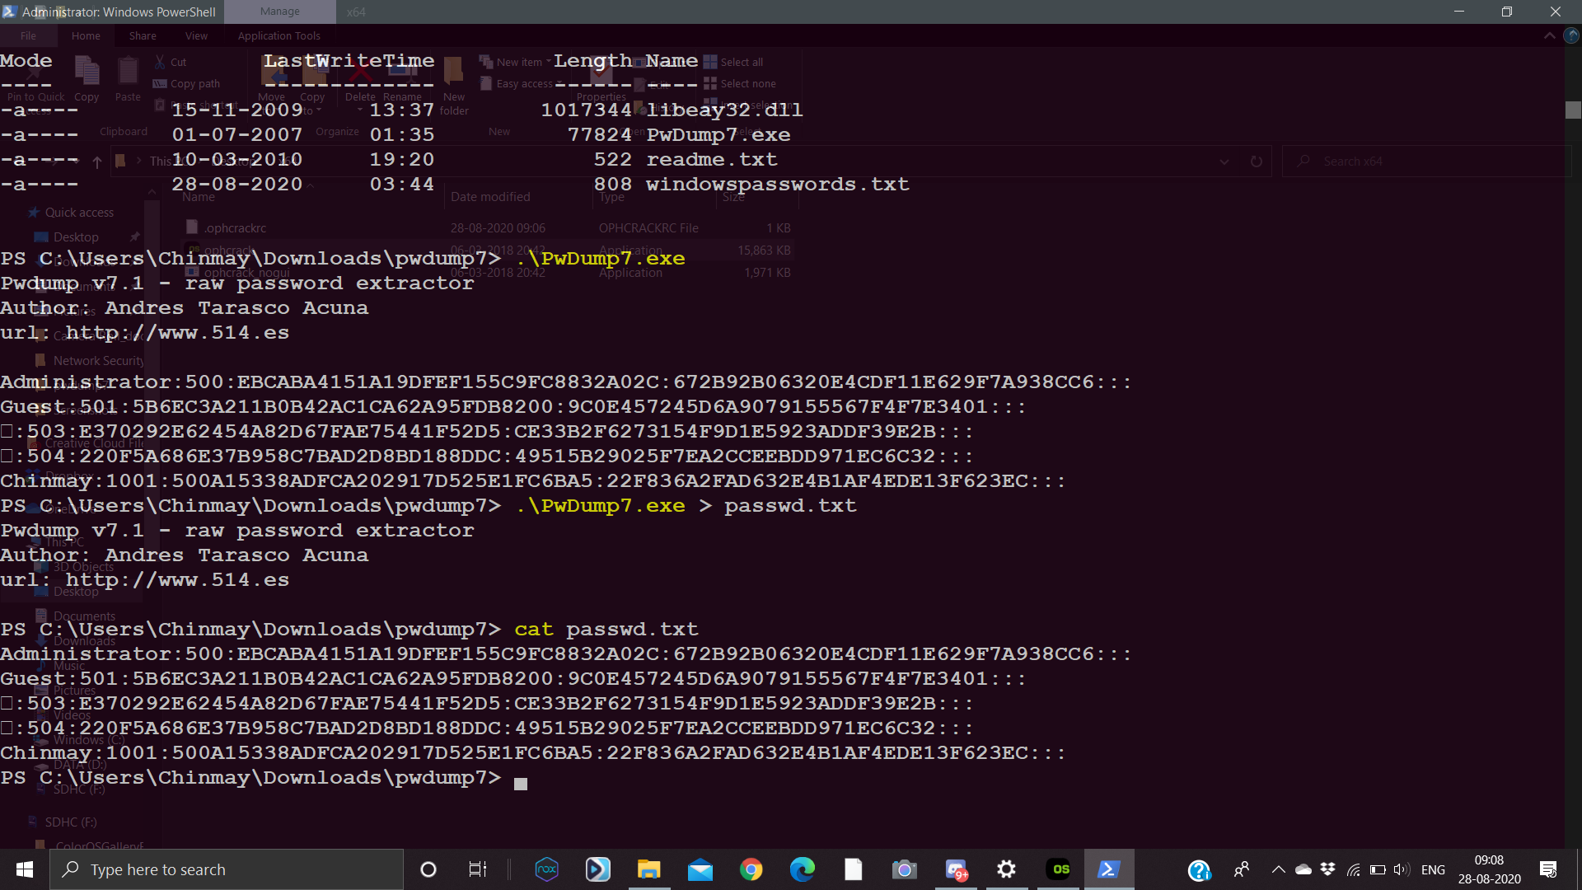
Step 3:
Verify that windows password.txt includes the usernames and password hashes for the local windows machine

Slide 33
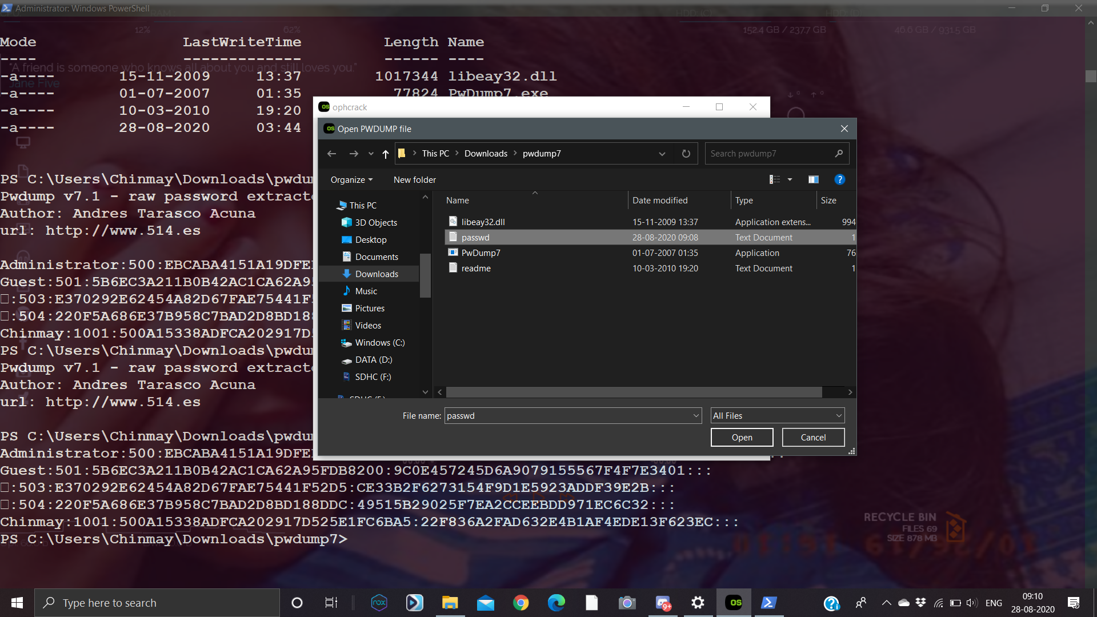
Step 4:
open & select pwdump [windowspasswords.txt] file in ophcrack

Slide 34
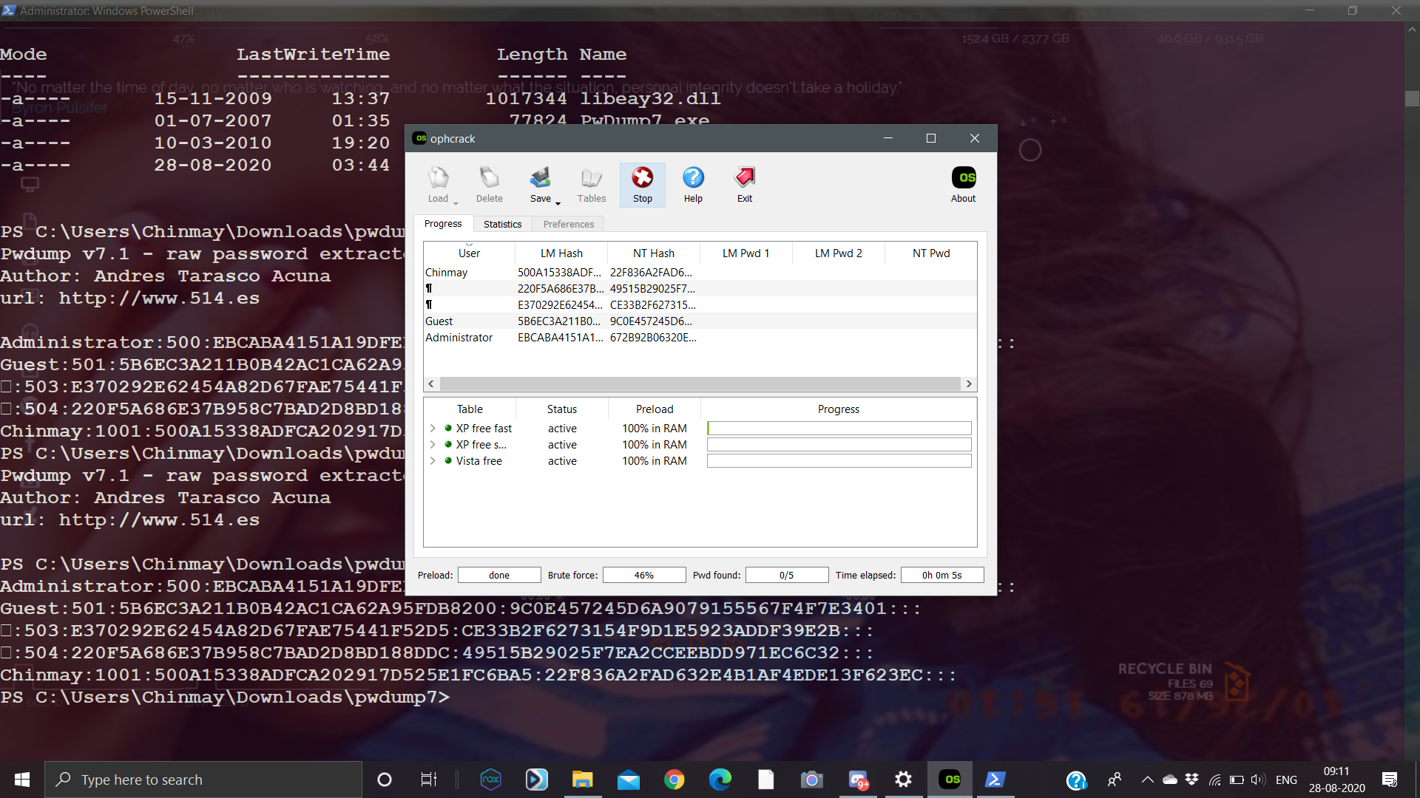
Step 5:
crack windowspasswords.txt file

Slide 35
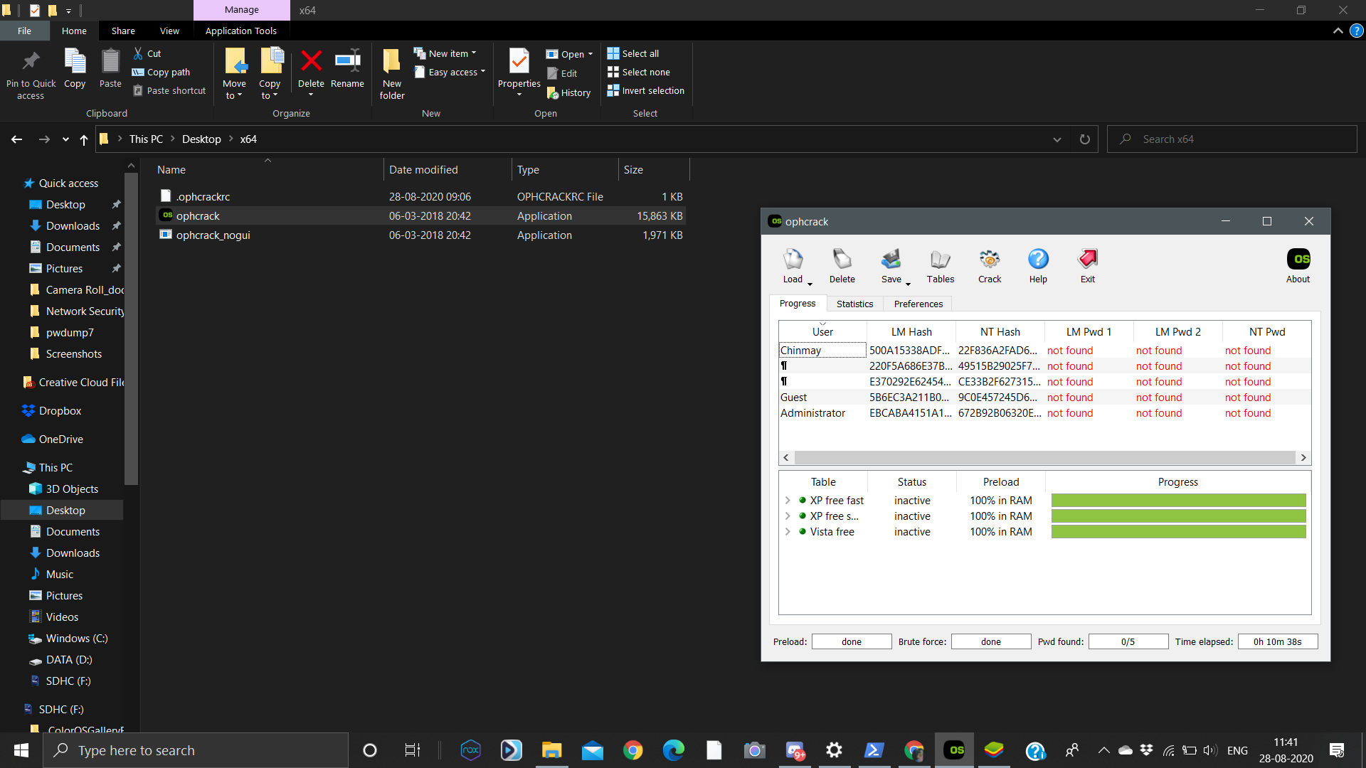
Step 5:
crack windowspasswords.txt file

Slide 36
Approx time to complete bruteforce (easy) Using simple forcing _ was around less than a minute for “raj123”..(refer screenshots given).
Could vary according to the password size,
Drawback- is that simple brute forcing requires a large space for wordlist txt,
And huge amount of time to compare all possible combinations.
Time for dictionary attack was about two hours for the password google123
And for the ophcrack it took 10 minutes to give results still unable to detect.

Slide 37
1. Tutorial: Browser - Refer the paper ”The Security Architecture of the Chromium Browser” and identify the security requirements for the web browsers. Also compare chrome with firefox with respect to only security parameters (or requirements).
1.Web browsers security architecture should focus on preventing the attacker from achieving three high-value goals:
Persistent Malware:
Transient Keylogger:
File Theft:
2.The web browser should be able to distinguish between a dishonest and an honest website, as for example in phishing attacks the attacker fools the client into confounding an untrustworthy site with an legitimate site.
3.It should also prevent an attacker who exploits an unpatched vulnerability

Slide 38
4.It should provide process granularity ,that is it should use separate instances for each tab that displays web content to provide fault tolerance in case of the rendering engine crash and should also display some trusted content, such as the interstitial warnings for HTTPS certificate errors and phishing sites.
5.It should provide greater defense against plug-in exploits.
6.Persistent Storage. The browser should ensure that the rendering engine cannot access the user’s file system directly. However, the rendering engine does require some access to the user’s file system to upload and download files.
Uploads: Clients can transfer records to sites utilizing the record transfer control. At the point when the client taps the structure control, the program shows a record picker exchange that lets the client select a document to transfer. In the event that the program piece didn't limit which documents the delivering motor could transfer, an aggressor who traded off the delivering motor could peruse a discretionary document on the client's record framework by transferring the document to attacker.com.
Downloads: While downloading a document, a site is allowed to keep in touch with the client's document framework. Or may be than keeping in touch with the document framework legitimately, the delivering motor uses the program portion API to download URLs. Left unchecked, an undermined delivering motor could manhandle this API to bargain the trustworthiness of the client's document framework.

Slide 39
7.Networking: Rather than accessing the network directly,the rendering engine retrieves URLs from the network via the browser kernel. Before servicing a URL request, the browser kernel checks whether the rendering engine is authorized to request the URL. Web URL schemes, like http,https, and ftp, can be requested by every instance of the rendering engine. However, the browser kernel prevents most rendering engines from requesting URLs with the file scheme, because a compromised rendering engine could read the user’s hard drive by requesting various file URLs.
8.User Interaction:Commodity operating systems expose an interface that lets applications interact with the user, but these interfaces are often not designed to be used by untrusted applications. For example, in the X Window System, the ability to create a window on an X server also implies the ability to monitor all of the user’s keystrokes .The browser kernel mediates the rendering engine’s interaction with the user to help enforce two security constraints:
Rendering: Instead of granting the rendering engine direct access to a window handle, the rendering engine draws into an off-screen bitmap.
User input : Instead of delivering user input events directly to the rendering engine, the operating system delivers these events to the browser kernel. The browser kernel dispatches these events according to the currently focused user interface element.

Slide 40
Comparison of chrome with firefox with respect to only security parameters (or requirements):
Firefox is implemented with a monolithic architecture that combines the rendering engine and the browser kernel into a single process image, while chrome has a modular architecture.
In typical configurations of Firefox 3 , the privileges include the full privileges of the current user. It can run in a “protected mode” , which runs the browser as a low integrity process. Running in protected mode, the browser is restricted from writing to the user’s file system, but an attacker exploiting a vulnerability can still read the user’s file system and exfiltrate confidential documents. The VMware browser appliance hosts Firefox inside a virtual machine with limited rights. The virtual machine provides a layer of isolation that helps prevent an attacker who exploits a vulnerability in the browser from reading or writing the user’s file system. The protection afforded by this architecture is coarse-grained in the sense that the browser is prevented from reading any of the user’s files, even files the user wishes to upload to web sites (for example, to a photo-sharing site or to attach to email messages at a webmail site).

Slide 41

THANK YOU

